Slide 1
stack overflow
app developed by:
Aly Myszewski, Kaitlin Walsh, Grace Ware & Jenna Zhu

Slide 2

overview
Stack Overflow is the exciting game where players can feel the satisfaction of making their favorite professor, Douglas Densmore, stressfully navigate through (seemingly) endless files all while avoiding the errors that cause you to fail and lose the game. The inspiration behind the game is to give students an opportunity to take their frustrations virtual and create an alternate universe where the student holds the entire fate of the Professor in their hands!

Slide 3
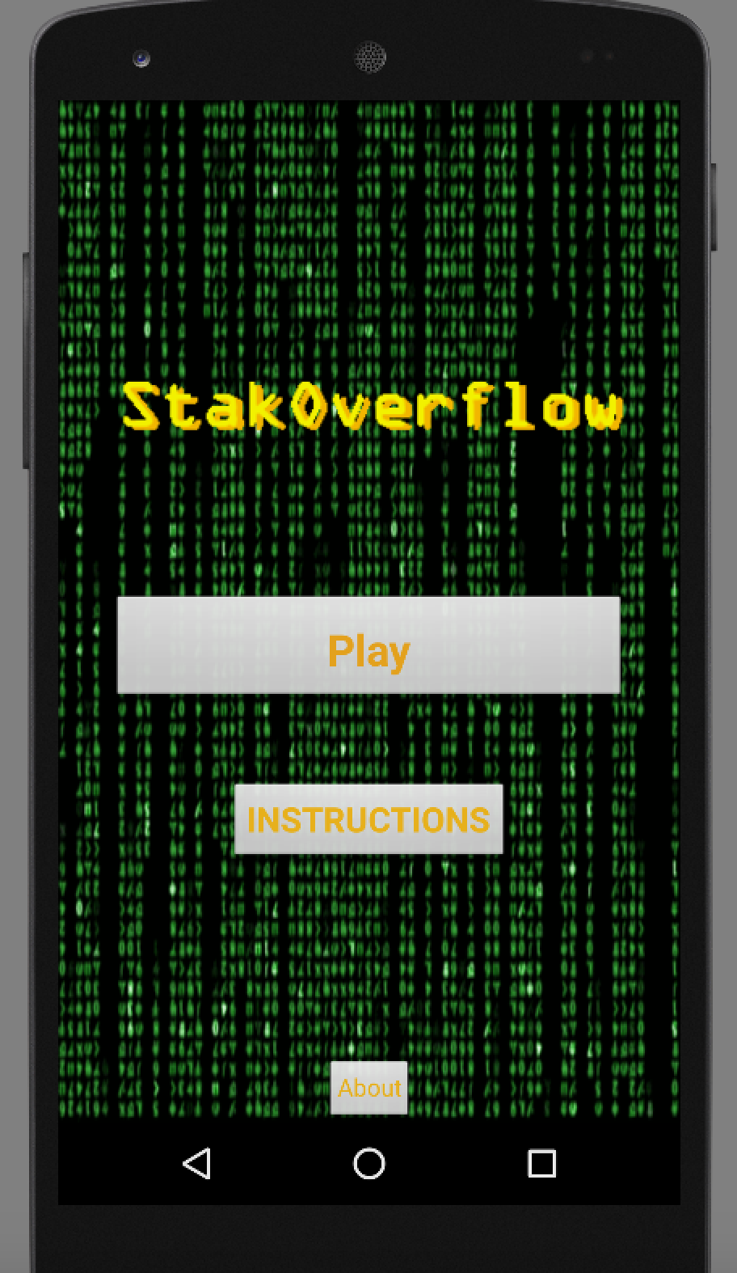
main game (menu) screen
Play Game: takes you to the game
Instructions: takes you to the instructions page where it explains how to play the game
About: about the developers, credits

Slide 4
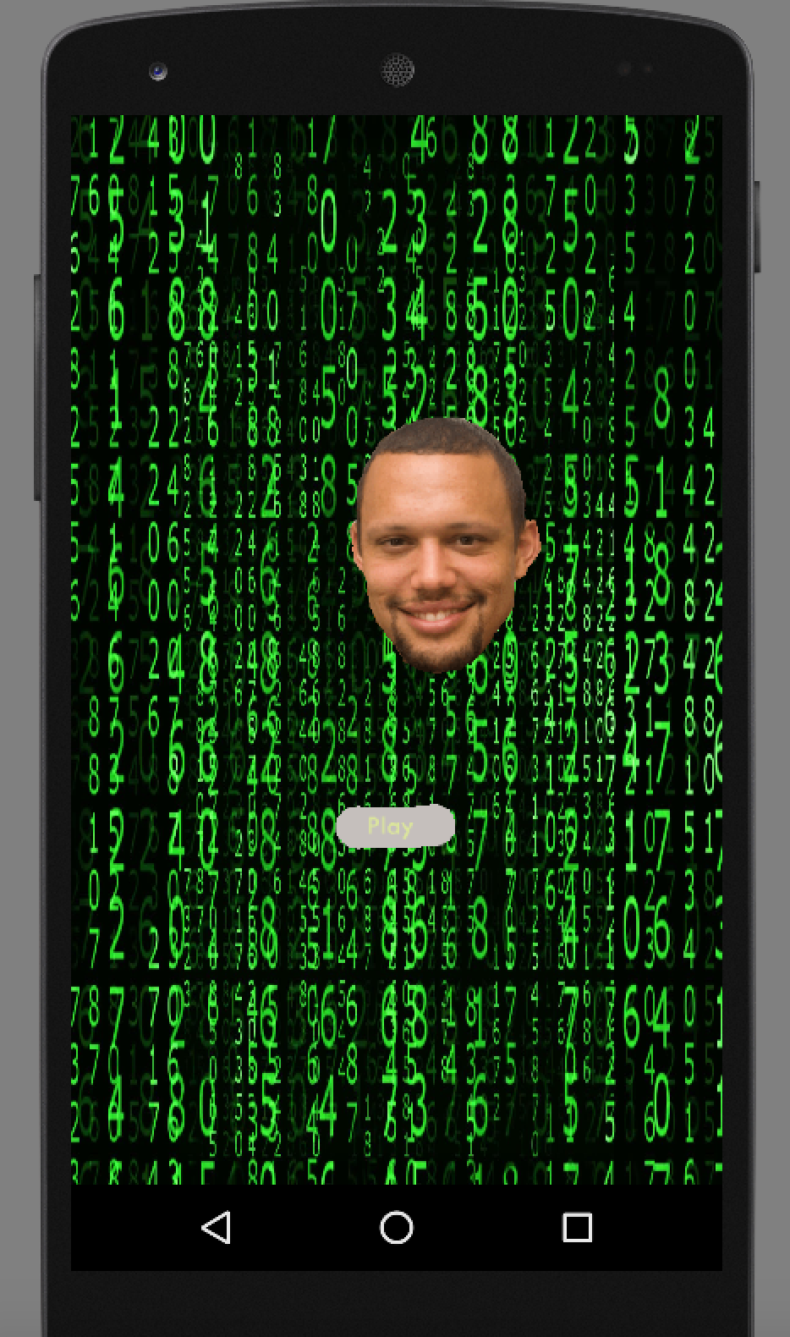
main screen
(Stack Overflow 2.0)

Slide 5
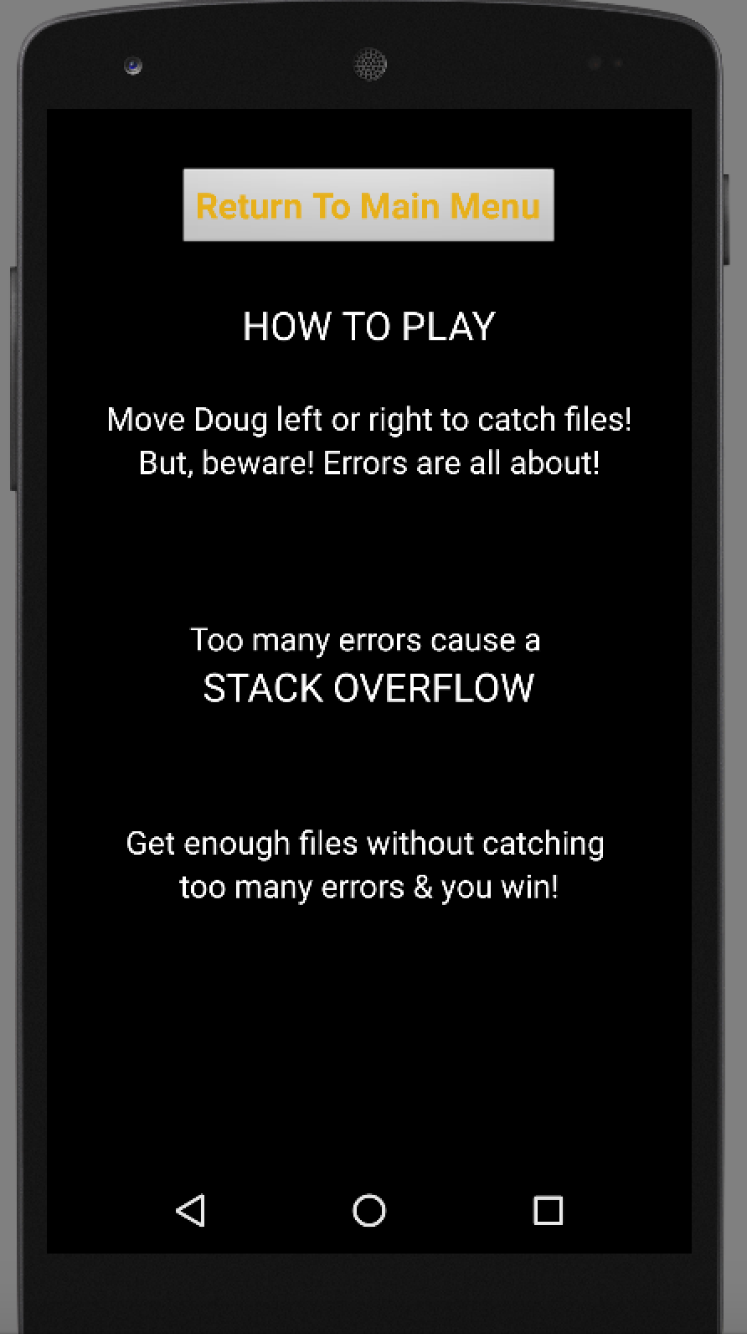
instructions

Slide 6
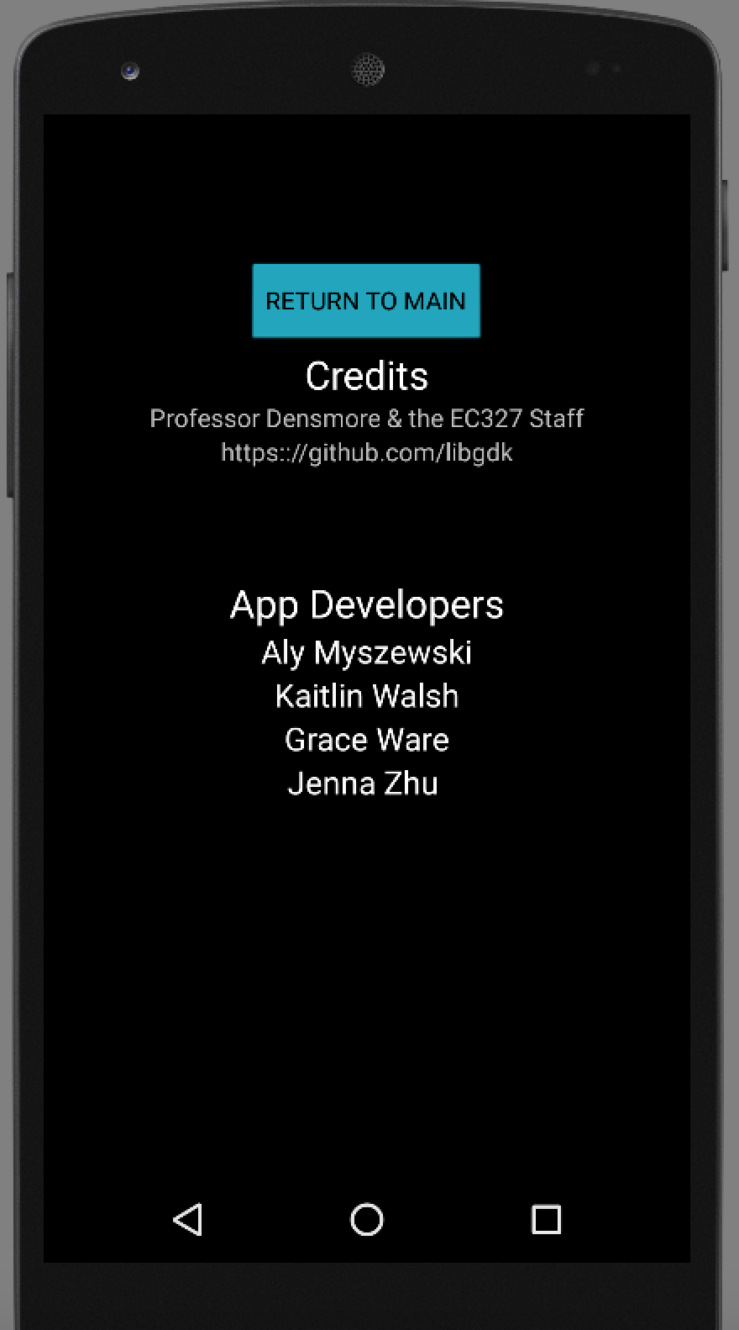
about

Slide 7
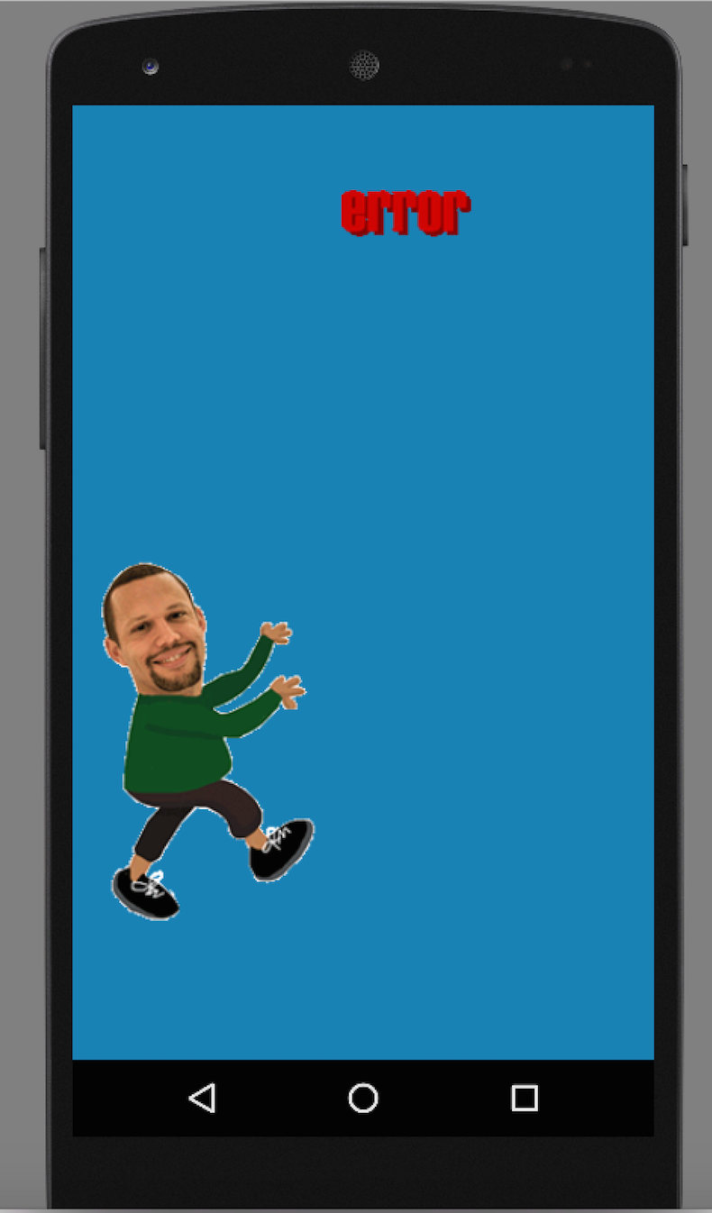
playing the game
The error moves back and forth at random x-values as it moves down, once it hits the height of densmore it pops back up to the original height where it was spawned.

Slide 8
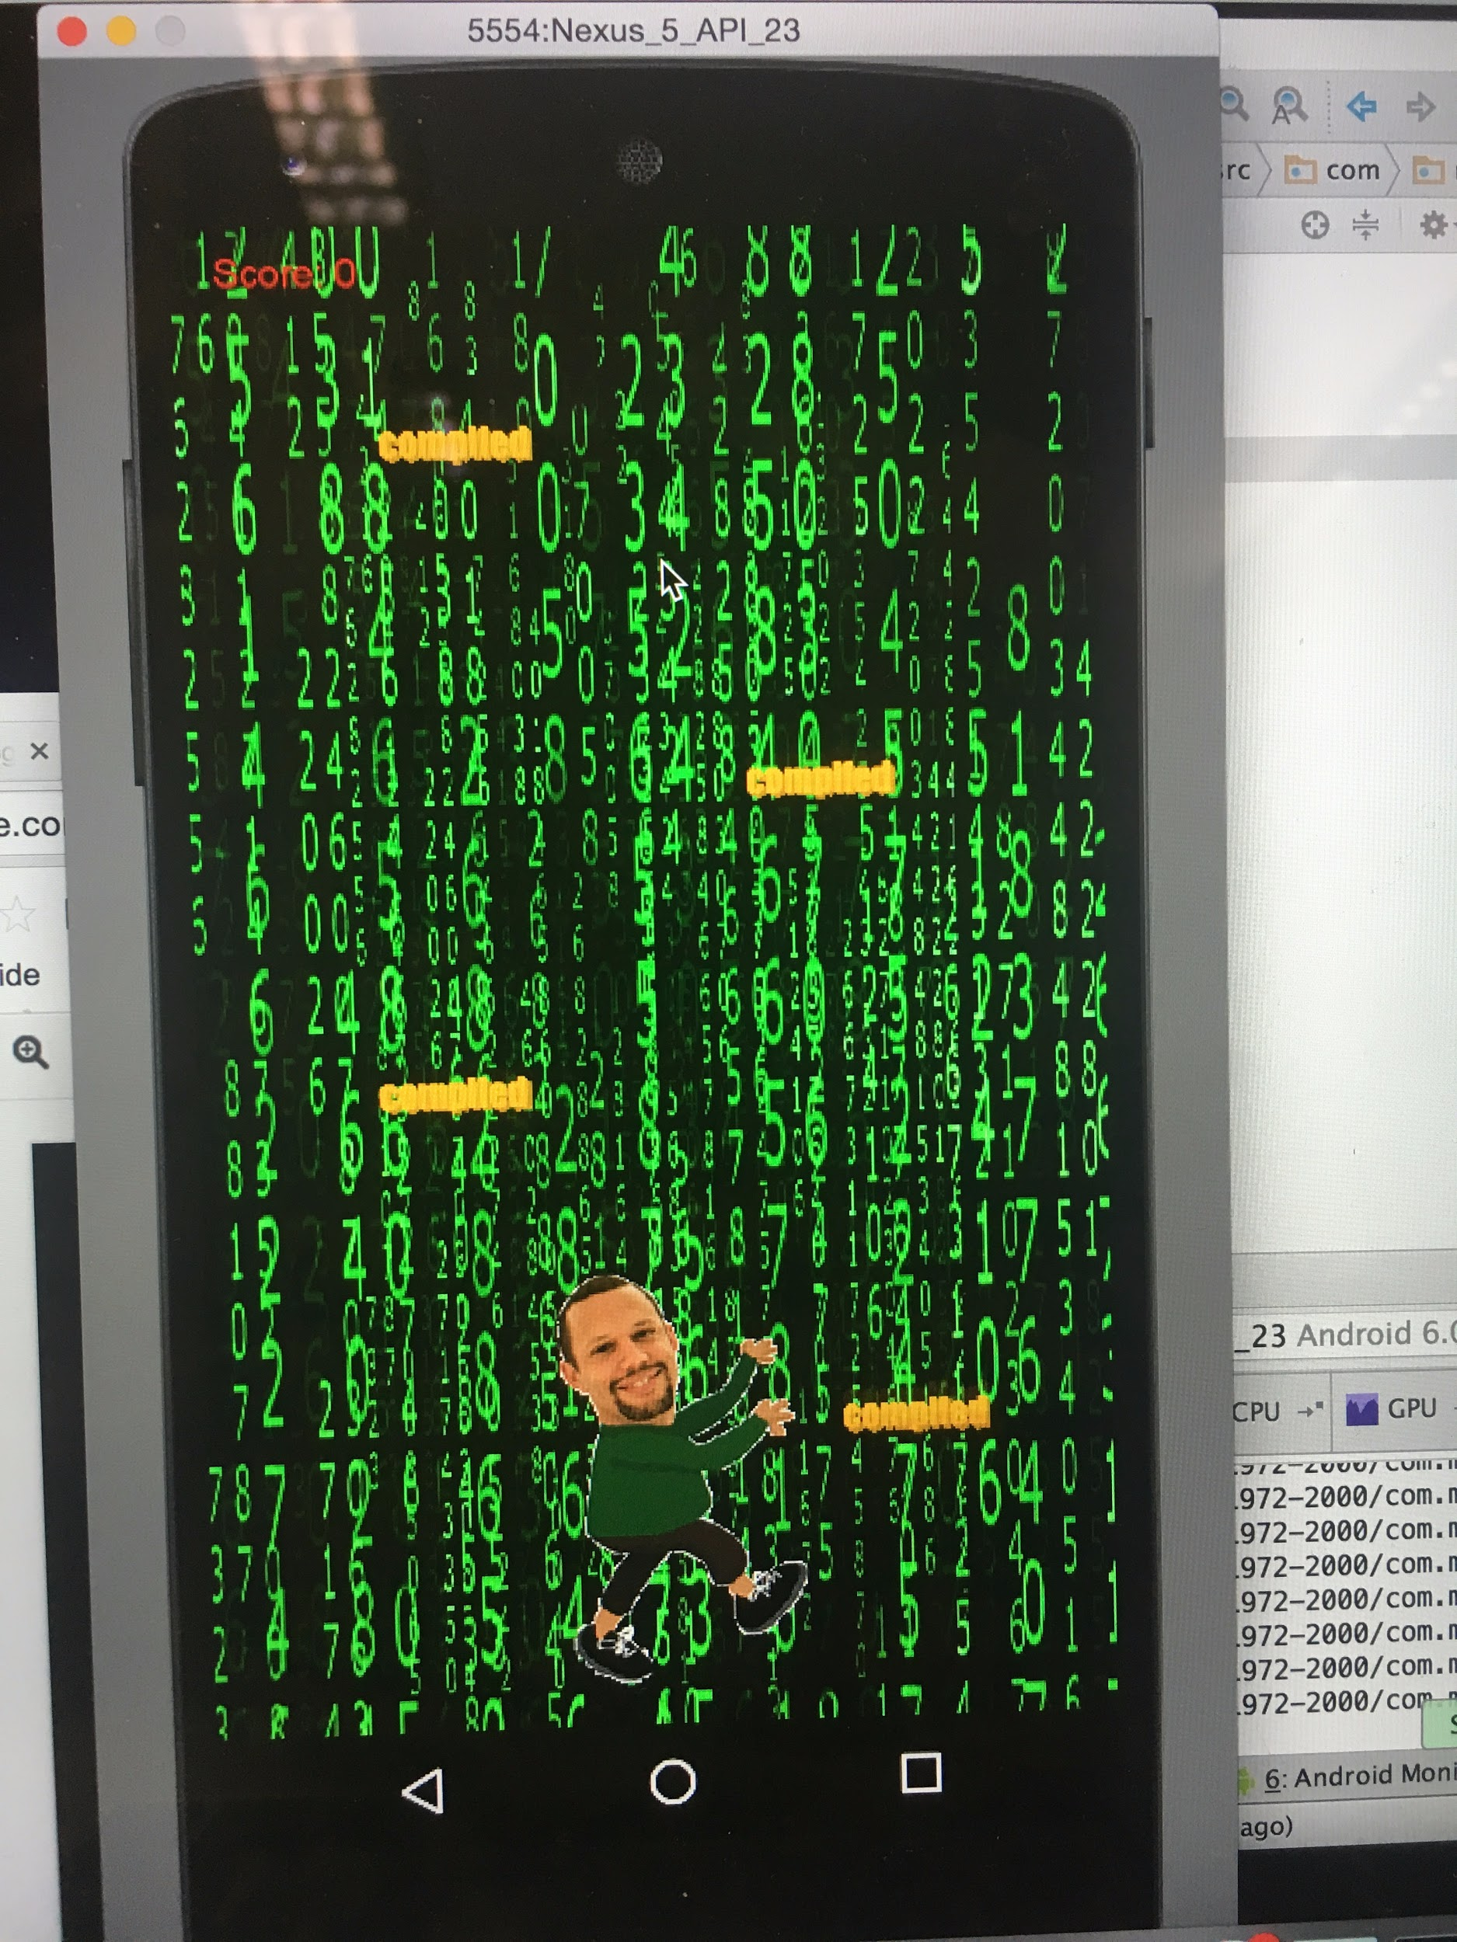
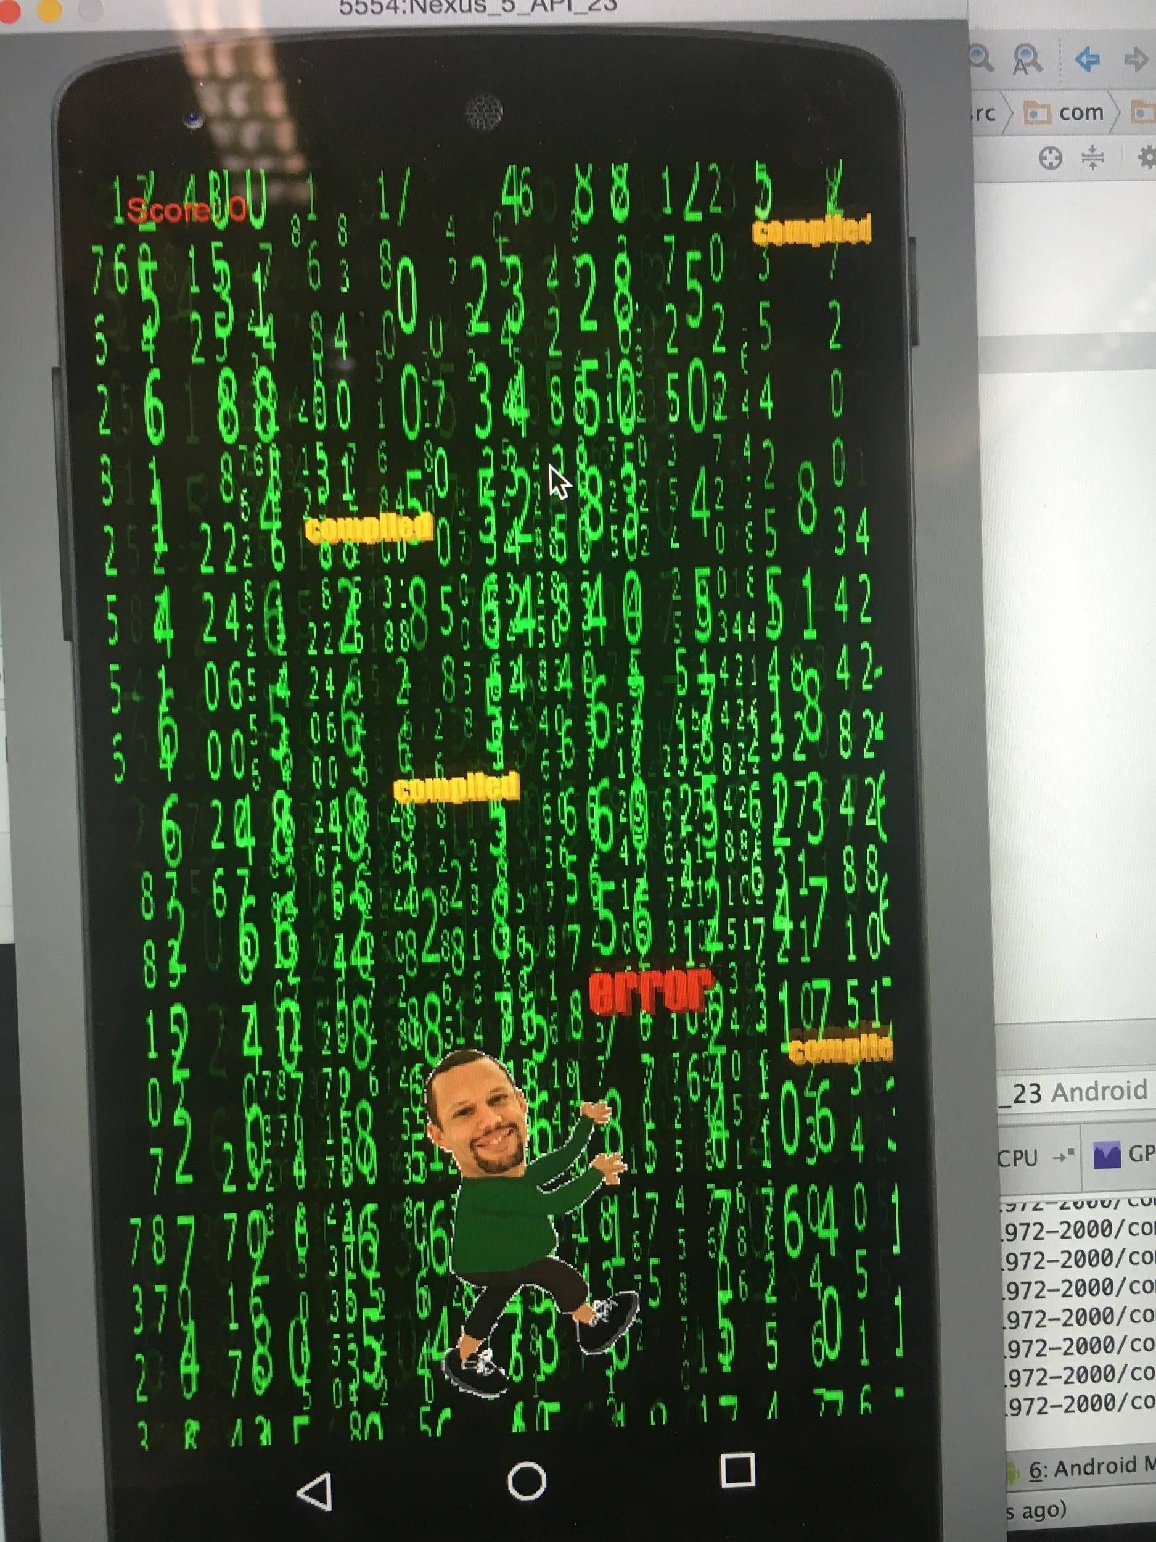
playing the game (Stack Overflow 2.0)
Drag Densmore back and forth and avoid the errors

Slide 9
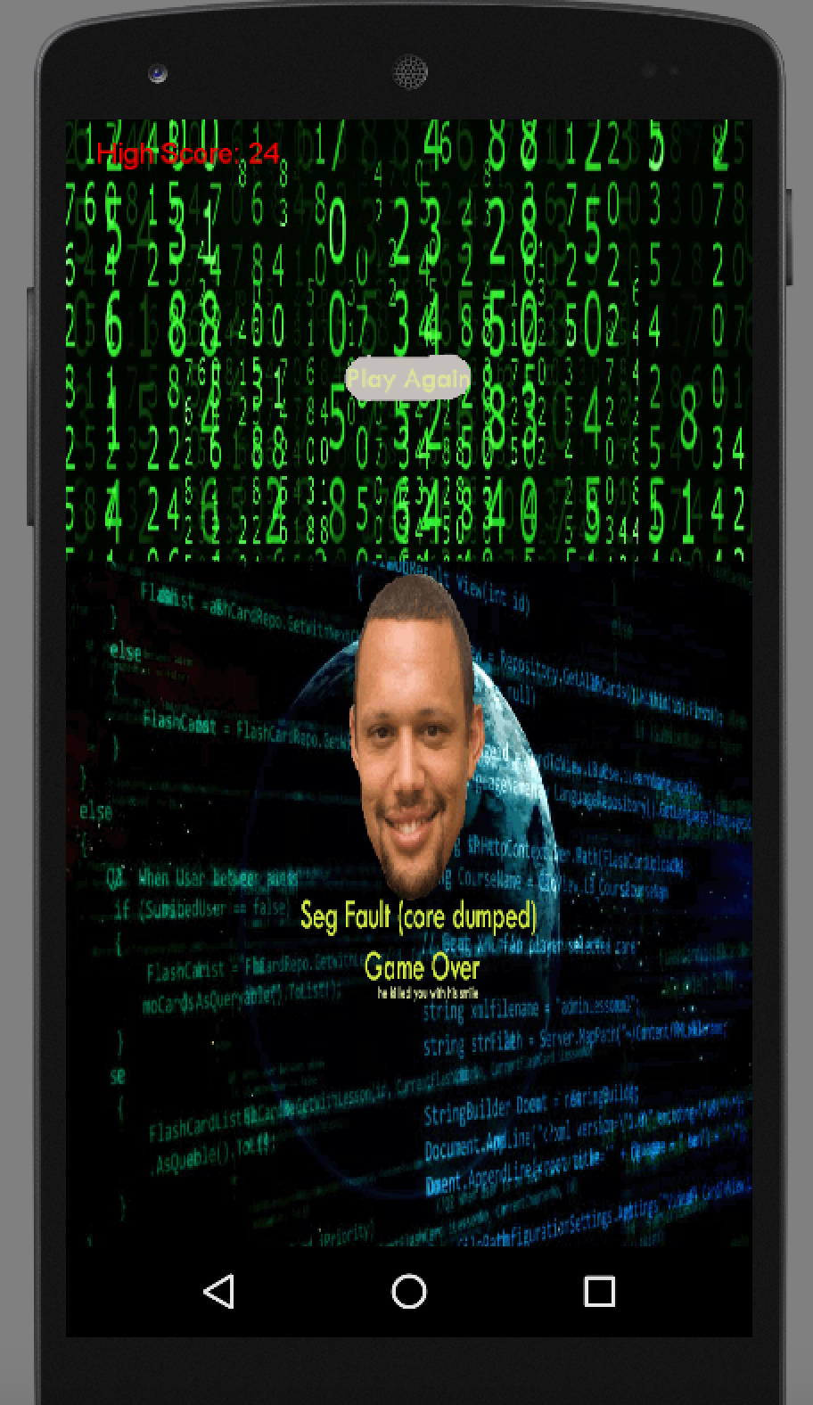
end game (Stack Overflow 2.0)

Slide 10

MAN, I CAN’T STOP PLAYING STACK OVERFLOW!

